Slide 1
Charitable Empower a woman, empower a nation.

Slide 2
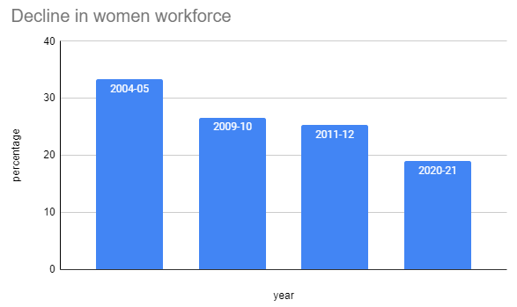
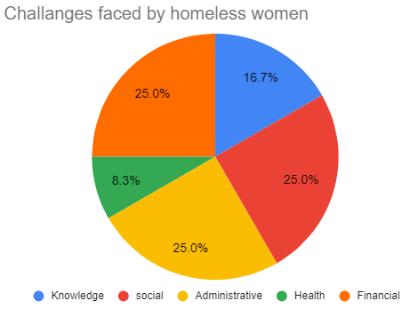
Motivation
India has witnessed a massive decline in women’s participation in the workforce.
About one fourth of them are facing financial problems. Some end up living on the streets or in a shelter, NGOs etc.,
Reasons being lack of knowledge, limited mobility, financial limitations, social barriers.

Slide 3
What is Charitable?
Charitable is a platform which aids women to be financially independent and improve their standards of living by providing them a unified platform with multiple features like providing training and certifications, donations to support their journey, job portal to provide job opportunities and a self employment portal to earn and start their own business using their skills and become strong and financially independent.

Slide 4
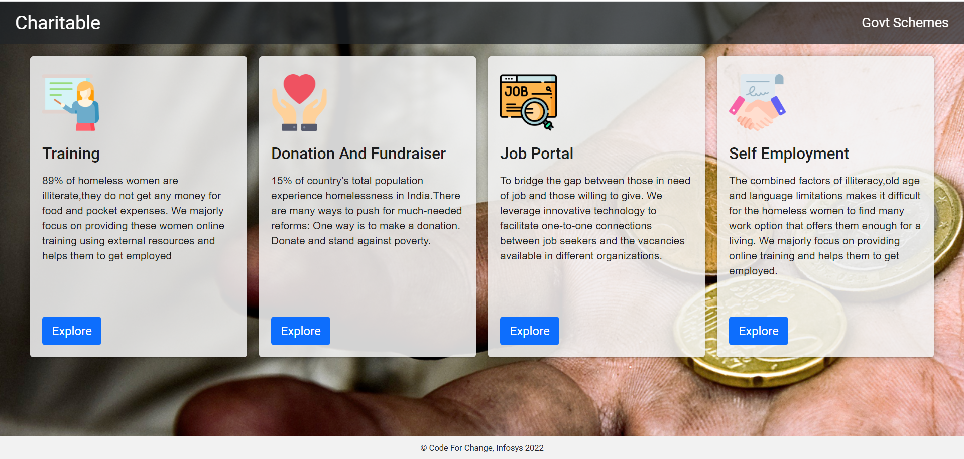
What Charitable provides?

Slide 5
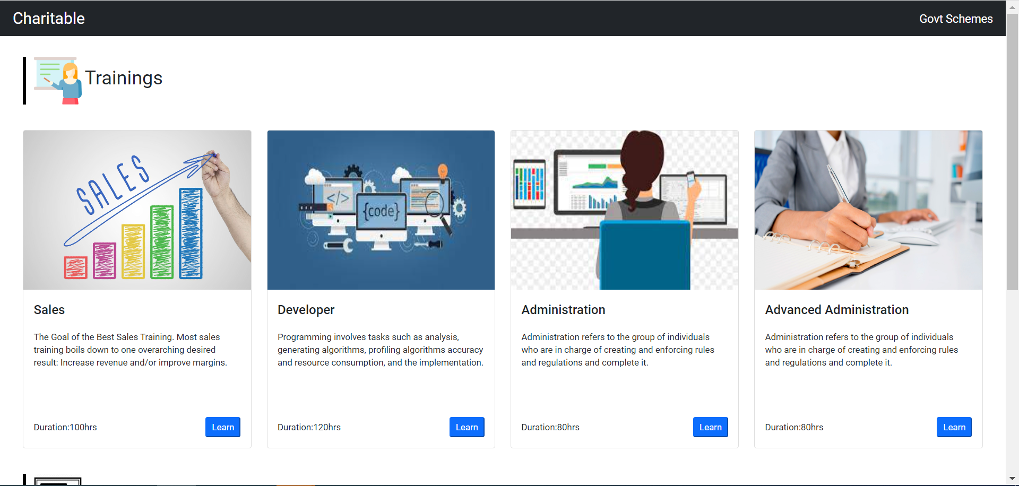

Training
Provides trainings on multiple courses related to various fields, which helps women to improve their skillset. The courses could be in house or from external resources using Azure data services.

Slide 6
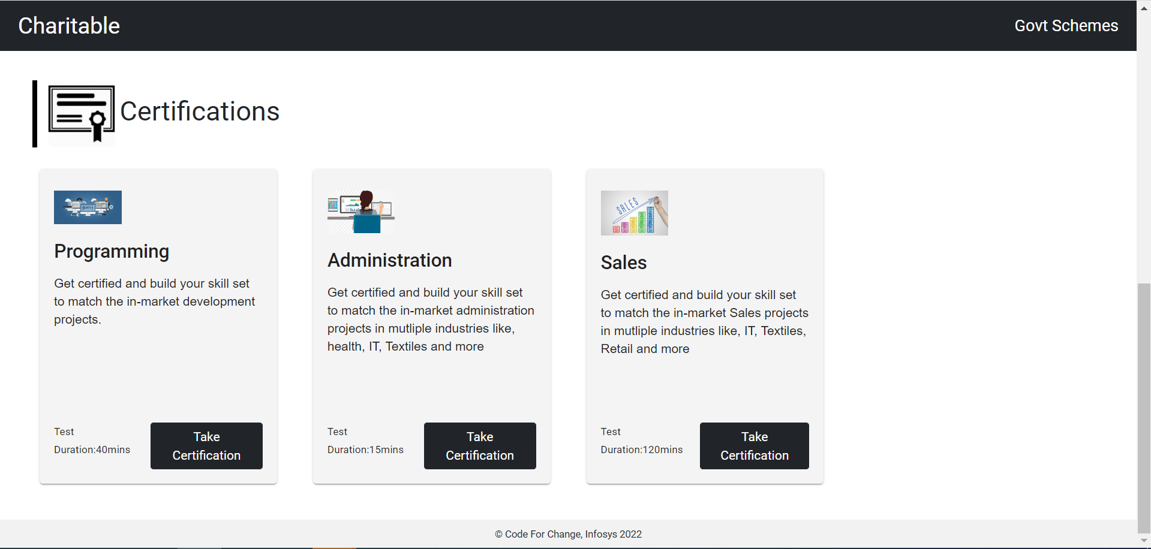
Certifications
Provides an option to take up certifications on various skills which help them to grab job opportunities and be financially independent.
Our platform will ensure high quality content trainings and certifications with minimal investment.

Slide 7

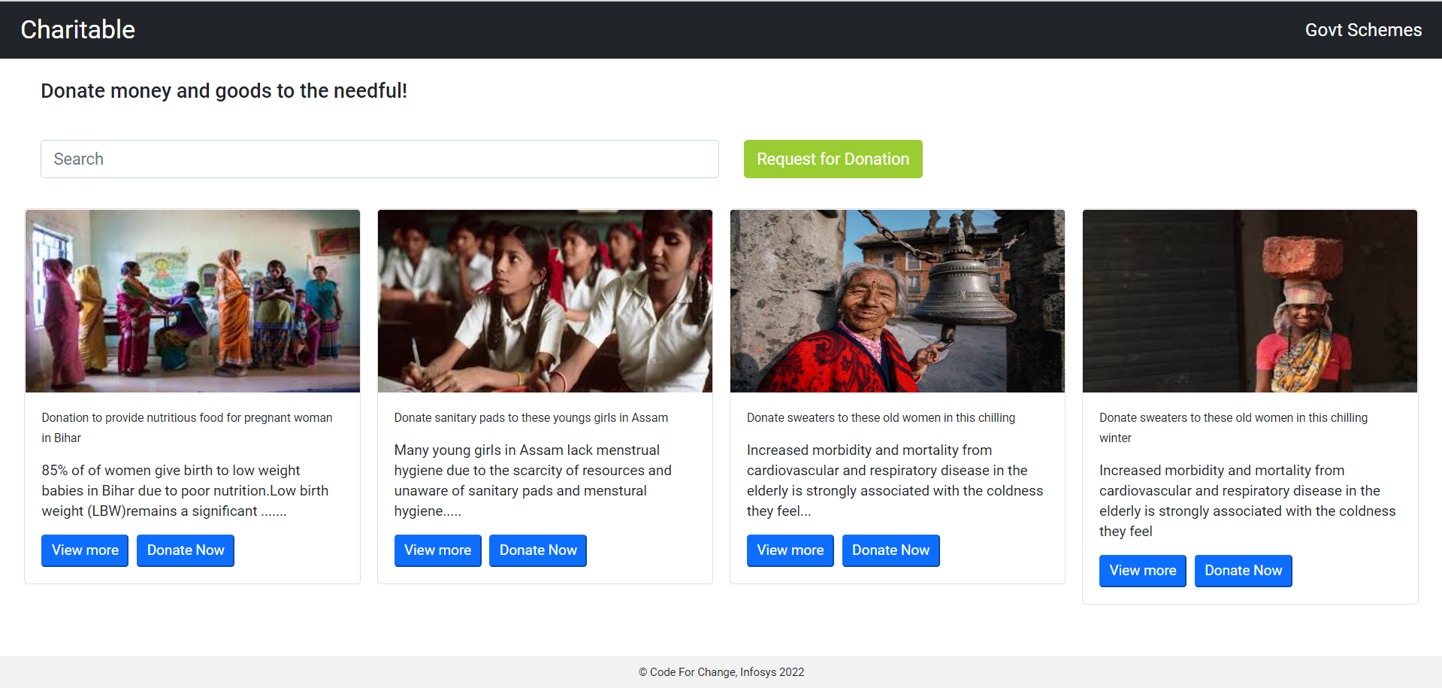
Donation and Fundraiser
Donator can search for a cause and donate multiple things like clothes, food, books, courses, money etc.

Slide 8
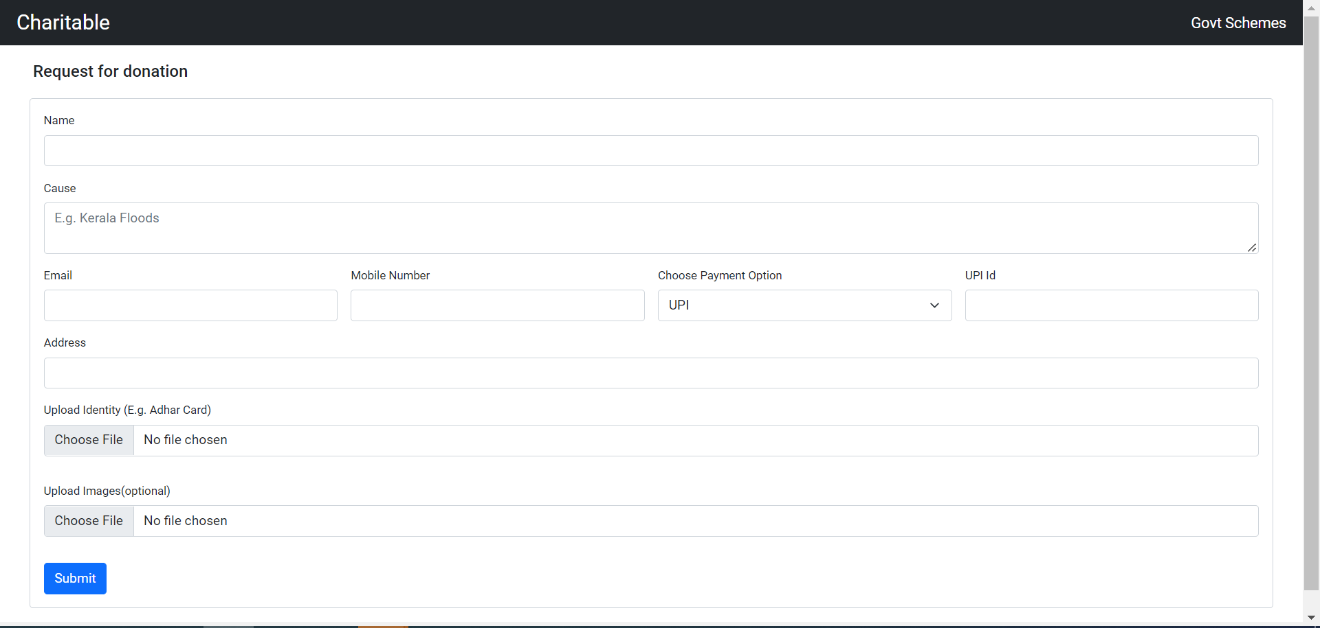
Donation and Fundraiser
Funds can be raised by providing basic details like cause, needs and contact details.
Requestor can request for some donation just by posting a request.

Slide 9
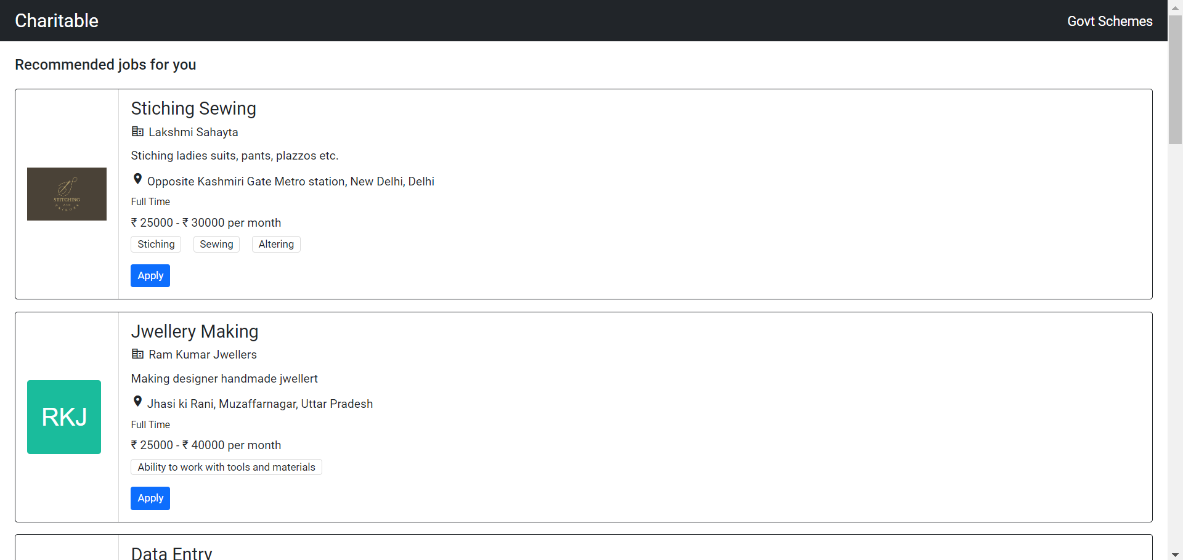
Job Portal
Provides women opportunities based on there skill set or the training and certifications they have taken up .
Dynamically provide suggestions to women and employers using Azure services.
e.g. women with skill set of stitching or sewing can be mapped to any tailoring or garment companies

Slide 10
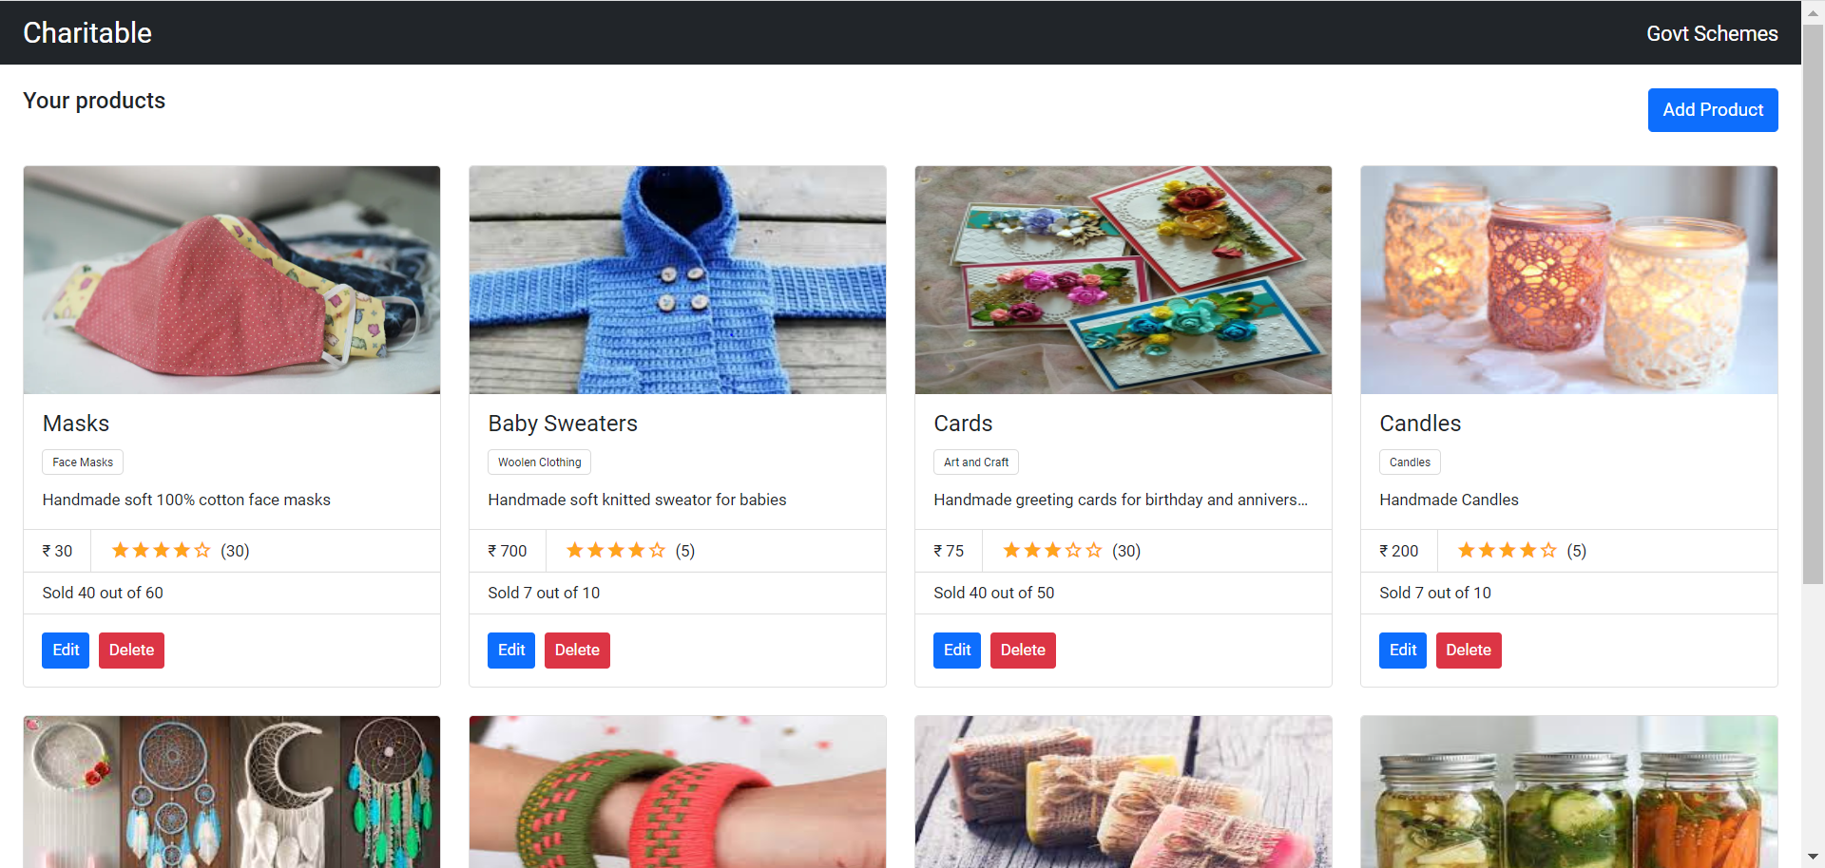
Self Employment
Provides a platform similar to marketplace which allows user to list and sell their products.
Products can include handicraft items, clothing items, food items , etc.

Slide 11
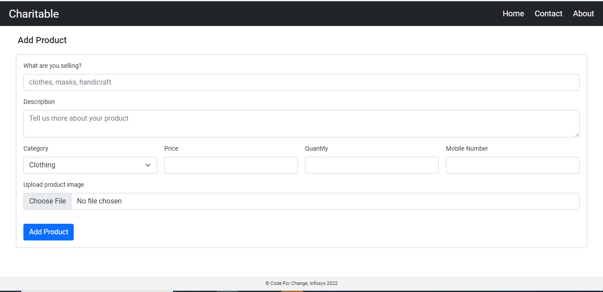
Add a product
User needs to put some basic details to list their product.

Slide 12
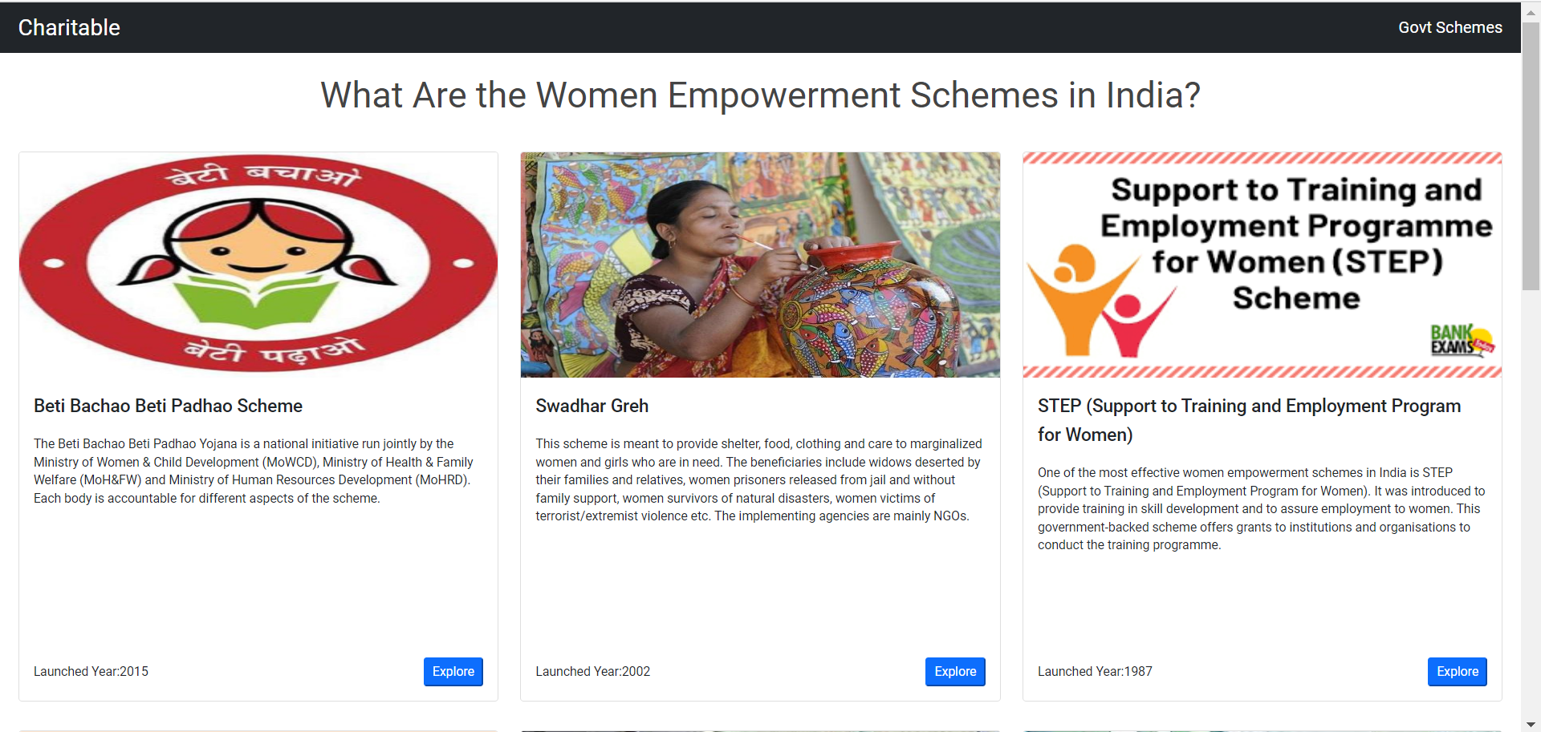
Government Schemes
Homeless women will be able to view and apply for the existing schemes available from government for their support.

Slide 13


Azure Tools
Charitable will make use of Azure to store and access the training content and dynamically provide suggestion to organization/ Employer using Azure services. Azure chat bot service will be used to provide support system to the women. Azure Notification hub will be used for notification services for the website. The site will make use of Microsoft AD for user management system.

Slide 14
Why choose charitable ?
1. Its a unique platform that bring NGOs, Small Scale Industries, Large Org with CSR funding etc., on a single portal to support homeless women.
2. Provides opportunities not only for professional skills but also traditional skills like knitting, clay modelling etc.
3. Have jobseekers not only for organized sector but also for unorganized sectors. It provides employer with the job seekers for unorganized sector as well as organized at a single platform which is not popular among other platforms.
4. Admin will have control over the range of products which can be sold on our platform. A screening will be there whenever someone posts a request for adding a new product or before it is listed.
5. Aids women to be financially independent and improve their standards of living by providing them a unified platform with multiple features like providing training and certifications, donations to support their journey, job portal to provide job opportunities and a self employment portal to earn and start their own business using their skills and become strong and financially independent.

Slide 15
Future Scope
The web application should be accessible in the regional languages.
Enable users to provide services like pet care, home care etc. along with products under the self employment feature.
Provide accessibility feature for disabled and illiterate women.

